Slide 1
Lecture 24
Democracy & the Media
April 20, 2017

Slide 2
The problem
  Democracy requires well-informed citizens.
  Can a media system dominated by large profit-driven corporations provide sufficient good quality information for citizens of a democracy?

Slide 3
The problem
  Democracy requires well-informed citizens.
  Can a media system dominated by large profit-driven corporations provide sufficient good quality information for citizens of a democracy?

Slide 4
II. Markets and the media

Slide 5
II. MARKETS & THE MEDIA
1. The Standard View
The free press = the free market press = free from government regulation = the “free marketplace of ideas”: only the best ideas (just like products) will survive the competition of the market.
Critical assumption: the only threat to a free press is government control, not private wealthy elites.

Slide 6
II. MARKETS & THE MEDIA
1. The Standard View
The free press = the free market press = free from government regulation = the “free marketplace of ideas”: only the best ideas (just like products) will survive the competition of the market.
Critical assumption: the only threat to a free press is government control, not private wealthy elites.

Slide 7
II. MARKETS & THE MEDIA
2. Four Problems with the Standard View
Problem #1. Private corporate control of media content
Problem #2. From competition to Oligopoly
Problem #3. Advertising and profit maximization
Problem #4. Cost-cutting vs quality as basis for competition

Slide 8
II. MARKETS & THE MEDIA
2. Four Problems with the Standard View
Problem #1. Private corporate control of media content
Problem #2. From competition to Oligopoly
Problem #3. Advertising and profit maximization
Problem #4. Cost-cutting vs quality as basis for competition

Slide 9
II. MARKETS & THE MEDIA
Concentration of Media Ownership
Number of corporations that dominate the media industry

Slide 10
II. MARKETS & THE MEDIA
2. Four Problems with the Standard View
Problem #1. Private corporate control of media content
Problem #2. From competition to Oligopoly
Problem #3. Advertising and profit maximization
Problem #4. Cost-cutting vs quality as basis for competition

Slide 11
II. MARKETS & THE MEDIA
2. Four Problems with the Standard View
Problem #1. Private corporate control of media content
Problem #2. From competition to Oligopoly
Problem #3. Advertising and profit maximization
Problem #4. Cost-cutting vs quality as basis for competition

Slide 12
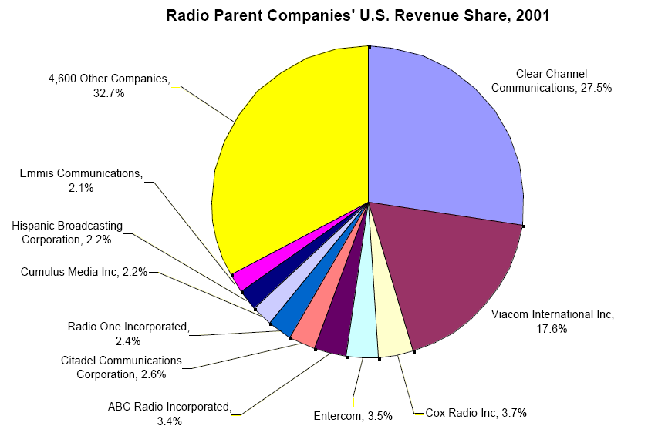
II. MARKETS & THE MEDIA
3. Deregulation: the case of radio

Slide 13
III. Alternatives:
revitalizing a democratic free press

Slide 14
III. ALTERNATIVES
A Fundamental Idea
A vibrant, high quality free press in the public interest is a public good. Capitalist markets generally do a poor job in providing public goods; public goods need some kind of systematic public support.

Slide 15
III. ALTERNATIVES
2. Three kinds of broadcast media
Commercial
State owned
Nonprofit/community media

Slide 16
III. ALTERNATIVES
3. Toward a Democratic Media System
What would it take to create a vibrant, democracy-enhancing media system in the United States?
Four key elements would include:
  Prohibit Media empires and conglomerates
  The public, noncommercial, nonprofit media sector should be the dominant sector in broadcasting
  Encourage diverse forms of ownership: employee cooperatives, community stations, university stations, non-profit corporations.
  Provide public subsidies but without state control.

Slide 17
III. ALTERNATIVES
3. Toward a Democratic Media System
What would it take to create a vibrant, democracy-enhancing media system in the United States?
Four key elements would include:
  Prohibit Media empires and conglomerates
  The public, noncommercial, nonprofit media sector should be the dominant sector in broadcasting
  Encourage diverse forms of ownership: employee cooperatives, community stations, university stations, non-profit corporations.
  Provide public subsidies but without state control.

Slide 18
III. ALTERNATIVES
3. Toward a Democratic Media System
What would it take to create a vibrant, democracy-enhancing media system in the United States?
Four key elements would include:
  Prohibit Media empires and conglomerates
  The public, noncommercial, nonprofit media sector should be the dominant sector in broadcasting
  Encourage diverse forms of ownership: employee cooperatives, community stations, university stations, non-profit corporations.
  Provide public subsidies but without state control.

Slide 19
III. ALTERNATIVES
3. Toward a Democratic Media System
What would it take to create a vibrant, democracy-enhancing media system in the United States?
Four key elements would include:
  Prohibit Media empires and conglomerates
  The public, noncommercial, nonprofit media sector should be the dominant sector in broadcasting
  Encourage diverse forms of ownership: employee cooperatives, community stations, university stations, non-profit corporations.
  Provide public subsidies but without state control.

Slide 20
III. ALTERNATIVES
3. Toward a Democratic Media System
What would it take to create a vibrant, democracy-enhancing media system in the United States?
Four key elements would include:
  Prohibit Media empires and conglomerates
  The public, noncommercial, nonprofit media sector should be the dominant sector in broadcasting
  Encourage diverse forms of ownership: employee cooperatives, community stations, university stations, non-profit corporations.
  Provide public subsidies but without state control.

Slide 21
III. ALTERNATIVES
  4. Two ways of providing public subsidies of information media as a public good
  Return airwaves to public control and treat as a public resource.
  Targeted Tax Credit (not tax deduction) for nonprofit media support

Slide 22
III. ALTERNATIVES
  4. Two ways of providing public subsidies of information media as a public good
  Return airwaves to public control and treat as a public resource.
  Targeted Refeundable Tax Credit (not tax deduction) for support of nonprofit media

Slide 23
III. ALTERNATIVES
  Proposal: Tax-financed journalism vouchers
  Each citizen receives a $200/year tax credit to give to a news journalism organization
  Organizations that receive tax vouchers have to meet certain criteria:
  Limits on advertising (maybe zero?)
  Nonprofit status
  Certified by an professional journalism association as a real news organization

Slide 24
III. ALTERNATIVES
  Proposal: Tax-financed journalism vouchers
  Each citizen receives a $200/year tax credit to give to a news journalism organization
  Organizations that receive tax vouchers have to meet certain criteria:
  Limits on advertising (maybe zero?)
  Nonprofit status
  Certified by an professional journalism association as a real news organization

Slide 25
III. ALTERNATIVES
  Proposal: Tax-financed journalism vouchers
  Each citizen receives a $200/year tax credit to give to a news journalism organization
  Organizations that receive tax vouchers have to meet certain criteria:
  Limits on advertising (maybe zero?)
  Nonprofit status
  Certified by an professional journalism association as a real news organization

